Slide 1

TypeScript
Future Proof Enterprise JavaScript Apps at Scale

Slide 2
1.
Intro
With whom am I speaking?
2.
JavaScript
Wat?!!!
3.
The Basics
Types, Interfaces, Classes, and Modules
4.
The Cool Stuff
Functions and Lambdas, Complex Type Definitions, Generics, Mixins/Decorators
5.
The Real World
Library Definitions, Compiler Options, AMD

Slide 3
Intro
With whom am I speaking?

Slide 4

Jeremy Likness
Wife, 2 children, vegan hiking 9-ball player
Started programming in the Commodore 64 days (yes, we had computers in the early 1980s)
Brief foray into game development with Quake in mid 1990s
Enterprise Developer for 20 years
Web Developer since, well, the web (1990s)
TypeScript Developer since beta in 2012 (six figures LOCs)
6-time Microsoft MVP
Author of 4 technology books
http://bit.ly/coderblog

Slide 5

iVision

Slide 6
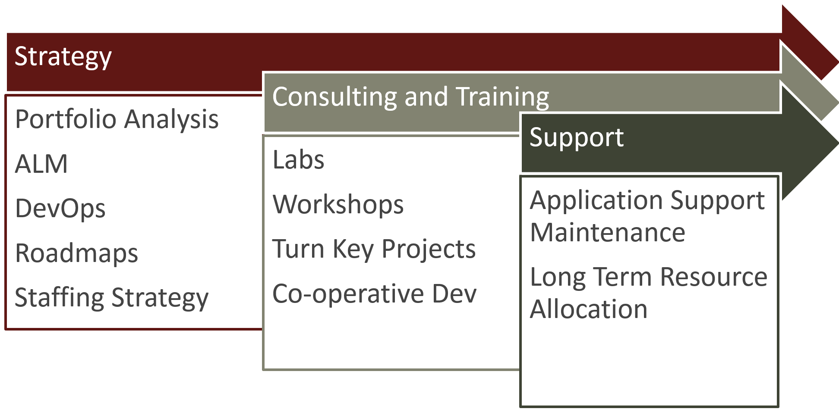
iVision App Dev
http://bit.ly/ivisionappdev

Slide 7
JavaScript
Wat?!!!

Slide 8
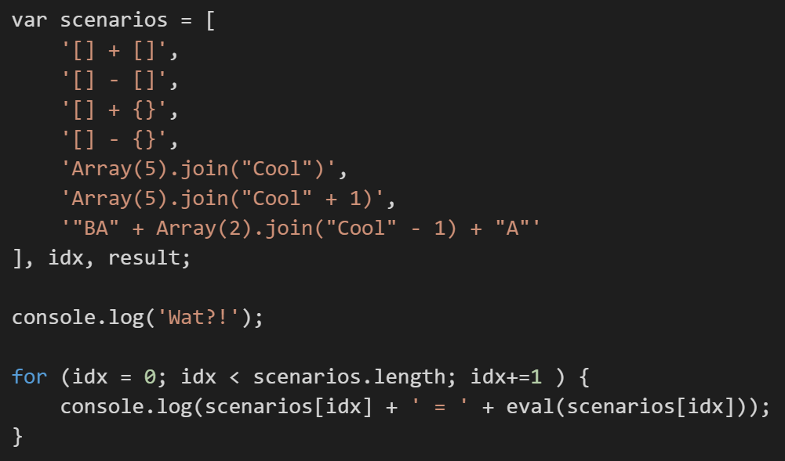
Wat?!

Slide 9
JavaScript Isn’t Going Anywhere
Adoption
1995
Mocha becomes LiveScript
1996
JavaScript
1997
ECMAScript 1.0
1999
ECMAScript 3.0
2005
jQuery
2015
ECMAScript 2015
Normalize the DOM
Written in 10 Days
Standards!
2012
TypeScript
Superset / Normalize JavaScript
2009
NodeJS

Slide 10
What About ECMAScript 6/2015 and Babel?
Popular Option
Introduces Classes, Lexical Scope, Lambda, etc.
Lacks:
Interfaces
Dynamic module affinity (SystemJS, RequireJS, etc.)
External library definitions
Generics
TypeScript = Superscript and is “future-proof”

Slide 11
TypeScript in the Real World
Discovery: intent is more clear with types, interfaces, etc.
Documentation: libraries make it easy to discover how to use APIs
Development Time Security: “fat-finger” mistakes less likely, even through complex iterations of calls and callbacks, won’t compile
Scope Safety: Modules, Classes, and Lambdas manage concepts of scope and “this” context
Team Scale: components make it easier for multiple teams to work in parallel
4x: Increased velocity for a team shifting from JavaScript to TypeScript with a data-binding framework (Angular)

Slide 12
The Basics
Types, Interfaces, Classes, and Modules

Slide 13
The Basics
Types
Interfaces
Classes
Modules

Slide 14
The Cool Stuff
Functions and Lambdas
Complex Type Definitions
Generics
Mixins and Decorators

Slide 15
The Real World
Library Definitions
Migrating JavaScript
Compiler Options
AMD

Slide 16



Questions?
https://github.com/jeremylikness
TypeScript2016Prez(code and deck)
6502emulator
http://bit.ly/coderblog
jlikness@ivision.com

